Slide 1
Education Expenses American Opportunity & Lifetime Learning Credits Tuition & Fees Deduction
Pub 17 Chapter 35
Pub 4012 Tab J
(Federal 1040-Lines 50 & 68)
Notes:
1

Slide 2
Claiming Education Expenses
Always address Education Expenses after all other return data is entered, so all other figures are finalized
Enter information in TaxSlayer for each of 4 ways education expenses can be claimed (if applicable). Note Federal and NJ refunds after trying each scenario to determine which is most beneficial (only 1 allowed for each student)
American Opportunity Credit (AOC)
Lifetime Learning Credit (LLC)
Tuition & Fees Deduction – expired for 2017
Business Expense on Schedule C

Slide 3
Claiming Education Expenses
Test each scenario and determine which method is most beneficial
Usually education expenses only impact the Federal return since NJ does not allow any education credits. However, depending on method chosen to claim the expenses on the Federal return, it is possible that NJ refund/balance due can be impacted. Always check combined results to determine best alternative
Information for AOC, LLC, and Tuition and Fees Deduction can all be entered on same screen. Check the appropriate box to have TaxSlayer calculate results using each method
Start with Tuition and Fees deduction, then LLC, then AOC
Business expense has to be calculated separately on Schedule C
Notes:
Start with Tuition and Fees deduction, which only requires you to enter qualified education expenses. When you move on to LLC, you will be asked to input data about the educational institution and to answer specific questions. That data stays in place when you move on to AOC. Since AOC is usually the best option (as long as taxpayer is eligible), all the required input data can just remain in place

Slide 4
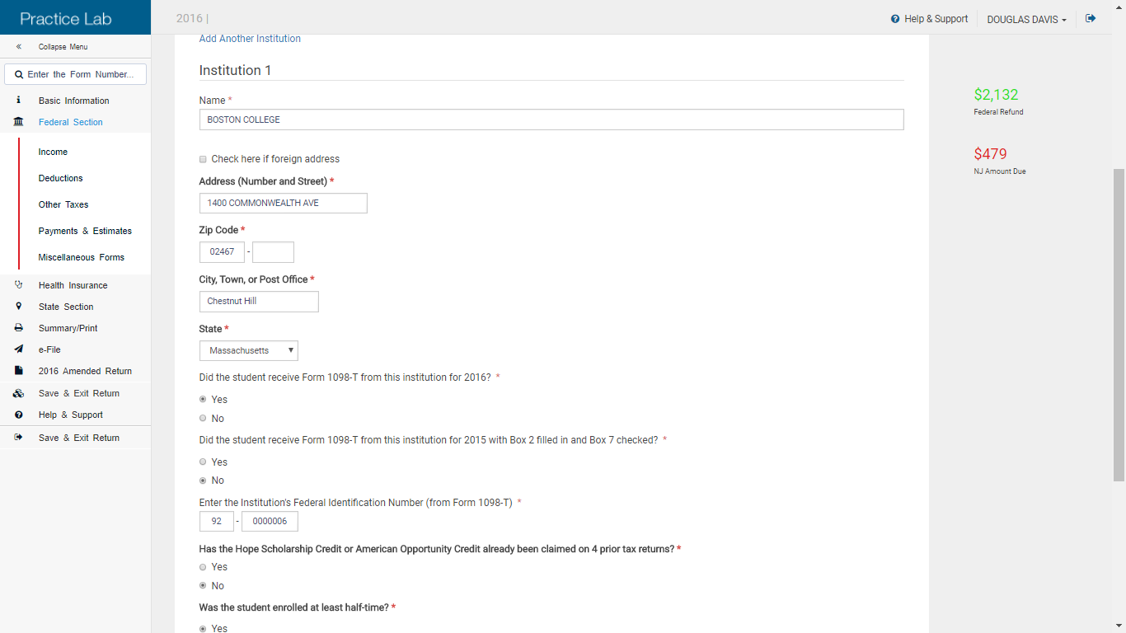
TS – Education Expenses – LLC or AOC Federal Section \ Deductions \ Enter Myself \ Credits Menu \ Education Credits (Form 1098-T)
(cont’d)
Add another institution if needed
Educational institution info
Questions pertinent to method you chose
to claim education expenses
Notes:
4

